Slide 1
Effect of an Atmospheric Pressure Plasma Treatment on the Mode I Fracture Toughness of a Co-Cured Composite Joint

Slide 2
1.Introduction
Convenient to co-cure the two materials using single processing process
Pros:
  Reduces cost
  Reduce processing time
Cons:
  Epoxy resin contains moisture(free and bounded) → interfacial failure
To eleminate the drawback:
  Apply plasma treatment on the surface → Too much treatment is detrimental

Slide 3
Most paper focuses plasma treatment on second bonding composite
This paper investigates the effect on co-cured joints

Slide 4
2.Manufacture&Methods
Materials:
177 °C cure unidirectional carbon-fiber/epoxy prepreg (CYCOM 977-2/HTS)
Dual 120/177 °C cure epoxy film adhesive (FM300-2M)
Each substrate consists 10plies of 977-2/HTS prepreg
Specimen:
Width:25mm Length:150mm Thickness:5.6mm Initial Crack Size:45mm

Slide 5
2.1 Fracture Test Methods
Double cantilever beam test with British Standards 7991
Constant crosshead displacement: 1mm/min
Three repeats on each specimen
2.2 Scanning Electron Microscopy Method
2.3 Thermal Characterisation Methods
Heated from 25°C to 350°C (10 °C /min)
To determine glass transition temperature

Slide 6
2.4 Surface Energy Characterisation
Sessile drop technique
Surface energy is calculated with OWRK method.
2.5 Labline Plasma Treatment System
Constant speed: 1.5 m/min
Applied only on two prepreg surface that direct contact with film adhesive
2.6 Optical Emission Spectroscopy
To analyze plasma content
Always N2 peaks in spectrum(diffusion of air into plasma)
He/O2 leads more interaction with prepreg → higher surface energy

Slide 7
2.6 X-Ray Photoelectron Spectroscopy
To study chemical composition of treated surfaces
Mean of 3 measurement on different spots

Slide 8
3 Result&Discussion
3.1 Surface Energy Analysis
Three gas mixtures:
  He
  He/N2
  He/O2
Power is fixed at 1200W
Maintained at 10L/min
Energy is measured after 2hrs

Slide 9
3.2 Mode I Fracture Toughness
He/O2 treatment at 1600W

Slide 10
3.3 XPS Analysis
Samples that treated with He/O2 at 1250W for 5 phase
The presence of sulphur (thermoplastic toughening agent or agent in resin)
Silicon concentration is in decrease(contamination)
3.4 Microscopy and Thermal Analysis
Long treatment → reduced fracture tougness in co-cured joints
????

Slide 11
4 Conclusion
He/O2 treatment is effective in increasing surface energy of prepreg.
He and He/N2 is very inefficient in increasing the surface energy.
Excessive treatments leads severe degradation in the performance under Mode I.
Highly polar surface attracts moisture to the interface.
Long plasma treatment causes pitting →reduction in fracture toughness

Slide 12
Mixed-Mode Fracture Toughness of Co-Cured and Secondary Bonded Composite Joints

Slide 13
1 Introduction
Drilling & bolding processes weakens the composite material
Superior method of using adhesive may improve stress distribution.
Co-cured joints suffer from trapped water inbeing released during the process.
  Affects the quality of the adhesive joint
An increase in the Mode I component increases Mode II percentage.

Slide 14
Aims is to link the experimentally measured fracture toughness with observed mechanism int he joint.

Slide 15
2 Materials & Manufacture of Joints
180 °C cure unidirectional carbon-fibre/epoxy prepreg (CYCOM 977-2/HTS)
A dual 120/180 °C cure epoxy film adhesive (FM300-2M)
  Contains polyester scrim cloth with random orientation.
Produced in-house, using vacuum bagging layup procedure
  120 °C or 180 °C
  Each consists 10 plies → grit-blastered to remove release agent and roughen
    CC180 = co-cured at 180 °C
    SB180= Secondary bonded at 180°C
    SB120= Secondary bonded120°C

Slide 16
3 Experimental Methods
3.1 Fracture Test Method:
Nominal Width = 25mm
Length = 150mm (DCB) and 190mm (ADCB/ELS)
Initial Crack Starter = 45mm(DCB) and 6mm(ADCB/ELS)
Total Thickness ~ 5.6mm

Slide 17
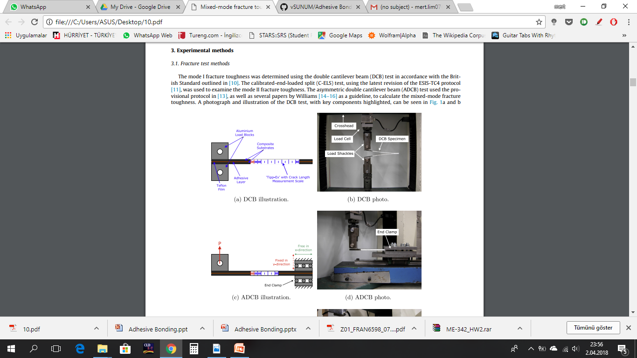
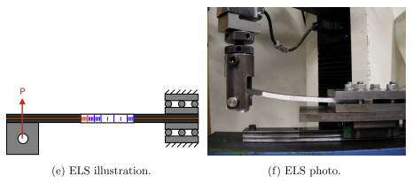
Mode I Fracture Toughness:
using double cantilever beam test (DCB)
Mode II Fracture Toughness:
using calibrated-end-loaded-split (C-ELS)
Mixed Mode:
usign asymmetric double cantilever beam (ADCB)

Slide 18
LEFM Method is applied → To create sharp crack.
  Loaded until crack propogates to 5mm
  Unload
  Then resume the loading
Crack length is monitored with x10 magnification.
Constant crosshead displacement rate of 1mm/min
Mode II crack propogaiton is unstable → ratio of crack length (a/L) > 0.55

Slide 19
3.2 Microscopy Method
Optical Microscope and Scanning Electron Microscope after fracture test
3.3 Thermal Characterisation Methods
Sample is heatedfrom 25 °C to 350 °C (at rate of 10 °C /min)
To determine the glass transition temperature of the adhesive

Slide 20
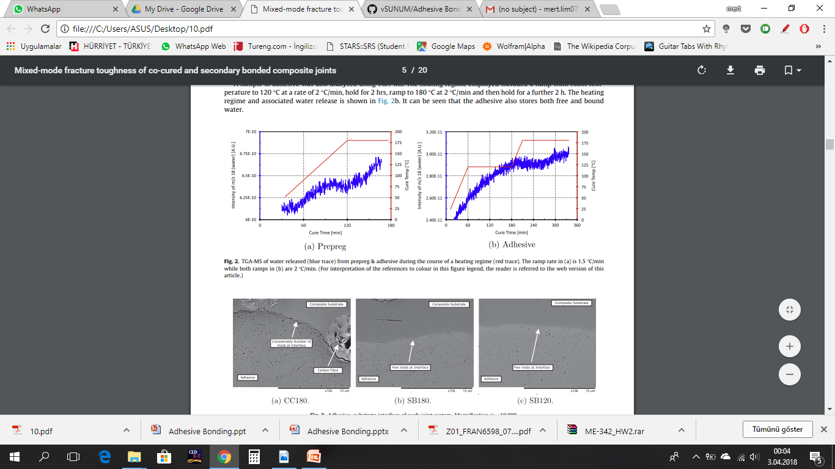
Fig. 2. TGA-MS of water released (blue trace) from prepreg & adhesive during the course of a heating regime (red trace). The ramp rate in (a) is 1.5 C/min while both ramps in (b) are 2 C/min. (For interpretation of the references to colour in this figure legend, the reader is referred to the web version of this article.)
Fig. 3. Adhesive–substrate interface of each joint system. Magnification is 10,000.

Slide 21
4 Result &Discussion
4.1 Initiation Fracture Toughness
Teflon film not giving a consistent starter defect
4.2 Propagation Fracture Toughness
R-curve beahviour is occured.
Fracture energy increases with higher percentage mode II.
Pure mode II fracture energy reaches 5-6 times of mode I.

Slide 22
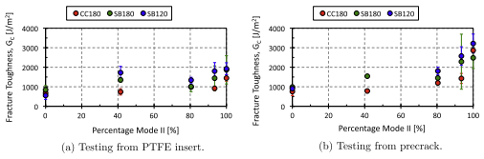
CC180 joint exhibits interfacial failure.
Secondary bonded failed either cohesively or interlaminarly
Interfacial failure in several CC180 in mixed-mode → by voids at the interface
Interlaminar failure in some SB180 and SB120 → grit-blastered surface

Slide 23
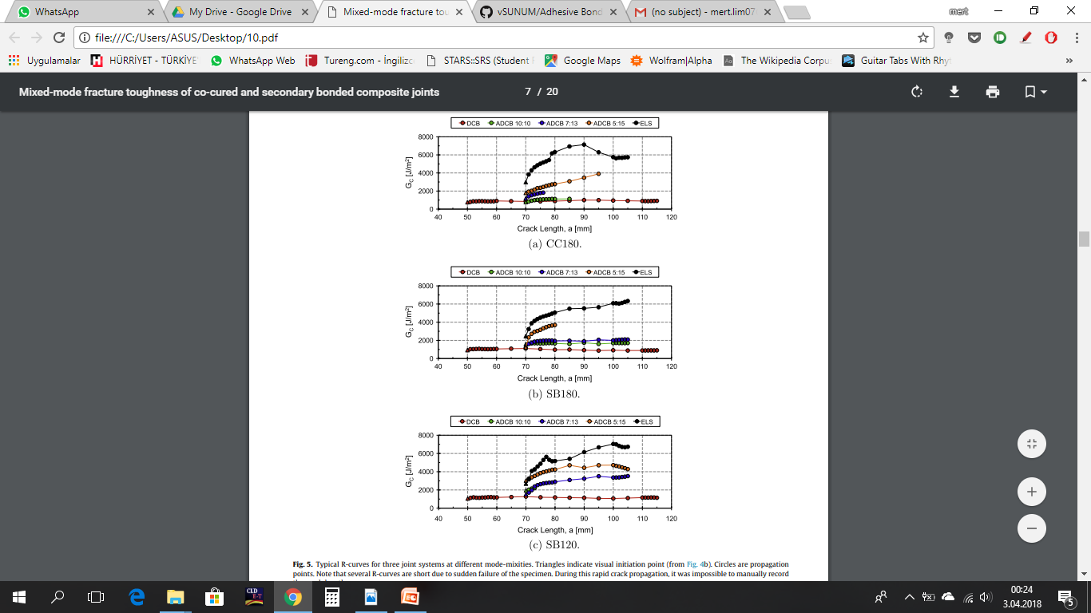

Slide 24
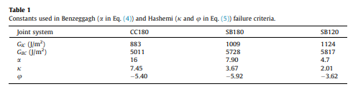
4.3 Failure Criteria
Experimental data fits Benzeggagh failure criteria
CC180 is by far the weakest
SB is the toughness

Slide 25
4.4 Thermal Analysis
Curing conditions affect the glass transition temperature of the adhesive.
Expected:
  Higher cure temperature of SB180 should have higher than SB120.

